Slide 1

SCHOOL OF COMPUTING DEPARTMENT OF COMPUTER SCIENCE AND ENGINEERING PROJECT WORK (CSE 499) Healthcare Predictor using ML Algorithm
PROJECT GUIDE BATCH MEMBERS – B16
Dr K Kartheeban Vamshikrishna B (9916004019)
Associate Professor Malasree R (9916004214)
Department of CSE Nagalakshmi P (9916004107)
KARE
Avancer software solutions Pvt. Ltd. – Chennai
26/05/2020

Slide 2
AGENDA
Abstract & Objective
1
Literature & Existing Cons.
2
Proposed Work
3
Modules Info. & Requirements
4
Demo & Paper Proof
5
References
6

Slide 3
ABSTRACT
Healthcare is the maintenance or improvement of health via the prevention, diagnosis, and treatment of disease, illness, injury, and other physical and mental impairments in human beings.
Health care is generally delivered by health professionals (providers or practitioners) in allied health fields.
It includes work done in providing primary care, secondary care, and tertiary care, as well as in public health.
Sometimes, it might have happened so many times that you or someone yours need doctors help immediately, but they are not available due to some reason.
At that time we need a online care and support.

Slide 4
OBJECTIVE
So, we are proposing a system named the Healthcare Prediction system.
It is an end user support and online consultation project.
It allows users to get instant guidance on their health issues through an intelligent health care system online.
Here we are using the machine learning technique mainly the supervised learning techniques to make the system more intelligent.
Initially, the system is fed with various symptoms and the disease or illness associated with those.
Then it trains the model (mainly random forest model) on symptoms on dataset and tune its parameters.
Finally the system allows user to share their symptoms and issues then it predict most accurate illness that associated.

Slide 5
LITERATURE
Combination data mining methods with new medical data to predicting outcome of Coronary Heart Disease – “Yanwei Xing, Jie Wang” , “Zhihong Zhao”:
They started prediction on Coronary heart disease (CHD).
The goal of this paper is to develop data mining algorithms for predicting survival of CHD patients based on 1000 cases.
They used SVM as model to predict the CHD with an accuracy of 79.1%.
They also tried using Neural networks which gives a poor accuracy than SVM.
An Incremental Decision Tree Learning Methodology Regarding Attributes in Medical Data Mining- “SAM CHAO”, “FAI WONG”:
In this paper, they used i+Learning (Intelligent, Incremental and Interactive Learning) theory is proposed to complement the traditional incremental decision tree learning algorithms

Slide 6
LITERATURE
But, many researches have been reported that decision trees with incremental learning ability, which is able to address the learning task with a stream of training instances only.
APRIORI algorithm based medical data mining for frequent disease identification – Gitanjali:
Here data mining is used to analyse a huge data from different perspectives and summarizing it into useful information.
In this paper, authors developed a method to identify frequency of diseases in particular geographical area at given time period with the aid of association rule based Apriori data mining technique.
Some researchers worked previously on predictive analytics in health care to predict the chronic kidney diseases using decision tree algorithm. (CSIT-2016 paper).

Slide 7
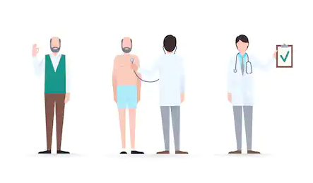
EXISTING CONS
The system is not fully automated, it needs doctors for full diagnosis.
We have to go to hospital for every small reason.
Disease diagnosis time is more.
User can’t discuss their illness to doctors immediately.
User need to wait for doctor until doctor come.
ML models cannot have user friendly nature to use by user.

Slide 8

PROPOSED WORK

Slide 9
PROPOSED WORK
Here we propose a system that allows users to get instant guidance on their health issues through an intelligent health care model online. (web application)
The machine learning model is fed with various symptoms and the disease or illness associated with it.
The front end interface allows user to share their symptoms and issues.
It then processes user’s symptoms to check for various illness that could be associated with it.
Here we use Random Forest a ensemble learning algorithm to predict the most accurate illness that could be associated with patient’s symptoms.

Slide 10
PROPOSED WORK
If the system is not able to provide suitable results means it informs the user about the type of disease or disorder it feels.
If user’s symptoms do not exactly match any disease in dataset developed, is shows the diseases user could probably have judging by his/her symptoms.
It also consists of doctor address, contacts along with Feedback and administrator dashboard for system operations.

Slide 11
MODULES INFO.
Anaconda:
Anaconda is a free and open-source distribution. It supports the Python and R programming languages for scientific computing and aims to simplify package management.
It is the industry standard for developing, testing, and training on a single machine, enabling individual data scientists to work on it.
In this project we use almost most of the machine learning tools like Scikit-Learn, Pandas, NumPy and SciPy which is pre-installed in anaconda and PyMySQL to deal with MySQL server.
Python:
Python is a general purpose and high-level programming language. You can use Python for developing desktop GUI applications, websites, Machine learning applications and web applications.

Slide 12
MODULES INFO.
So, in this Health care predictor we use Python as a language to implement both machine learning work and website work with the help of flask framework.
Scikit-Learn:
Sk-learn an open source Python library that implements a range of machine learning works like pre-processing, cross validation and tuning with its rich algorithms using a unified interface on the data provided and accumulated in the system to generate various models.
In our project we use Pandas module to read the csv file which contains comma separated values and convert that into a pandas DataFrame.
Scikit-Learn simple and efficient algorithms helps to split the data set to test and train samples for compiling under various algorithms to improve the accuracy by opting the best supervised model.
The SVM, Random forest, statistical modelling, decision tree analysis and logistic regression can be carried out in one place making it simple and robust for our project. |

Slide 13
REQUIREMENTS
OS : WINDOWS 10
RAM : 4GB or more
Script : Python 3.5+
Environment : Anaconda 5.3
Libraries : NumPy 1.16.0, Pandas 1.0.3, Matplotlib 3.2.1, Seaborn 0.10.1, Scikit-Learn 0.2
Front End : HTML5, CSS3
Database : MySQL 6.0

Slide 14
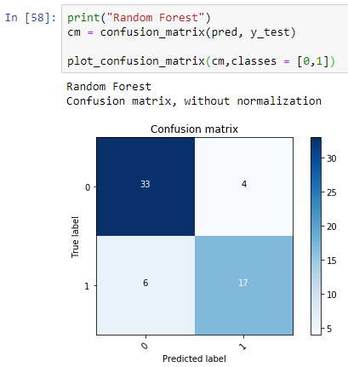
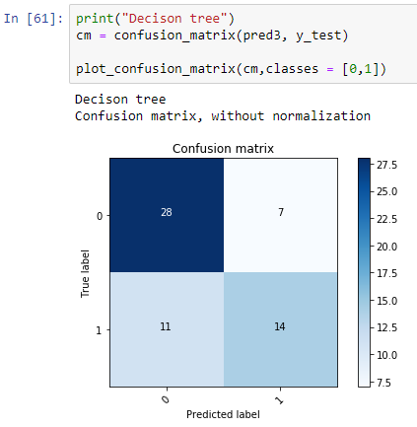
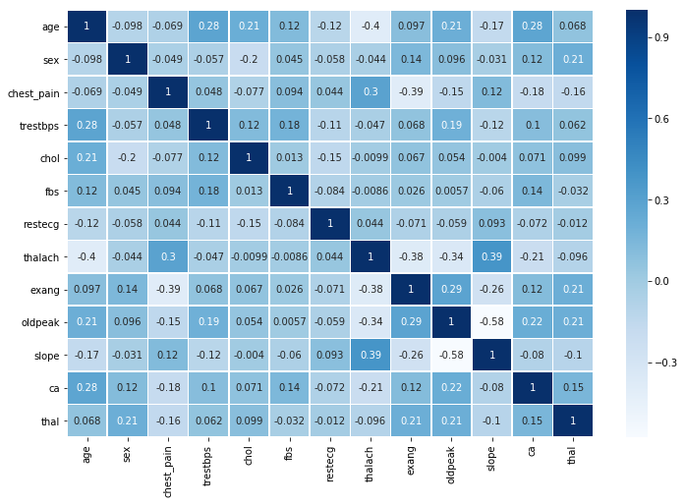
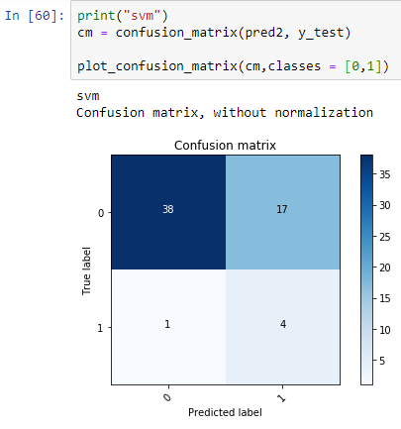
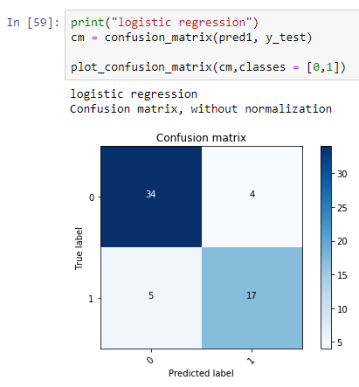
CORRELATION GRAPH ON DATASET
CONFUSION MATRIX OF 4 MODELS

Slide 15
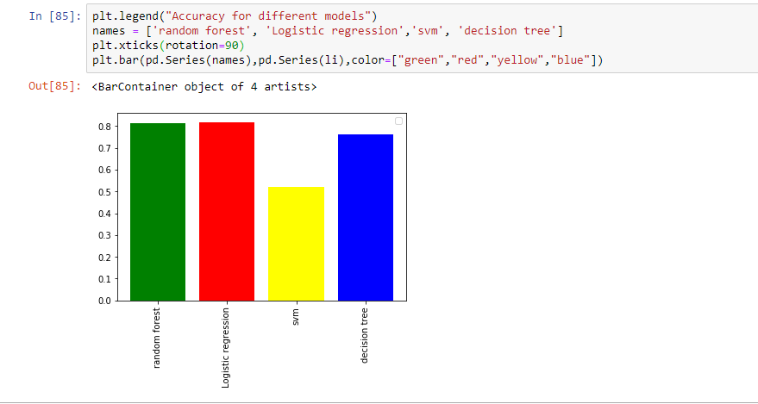
ACCURACY BAR GARPH

Slide 16
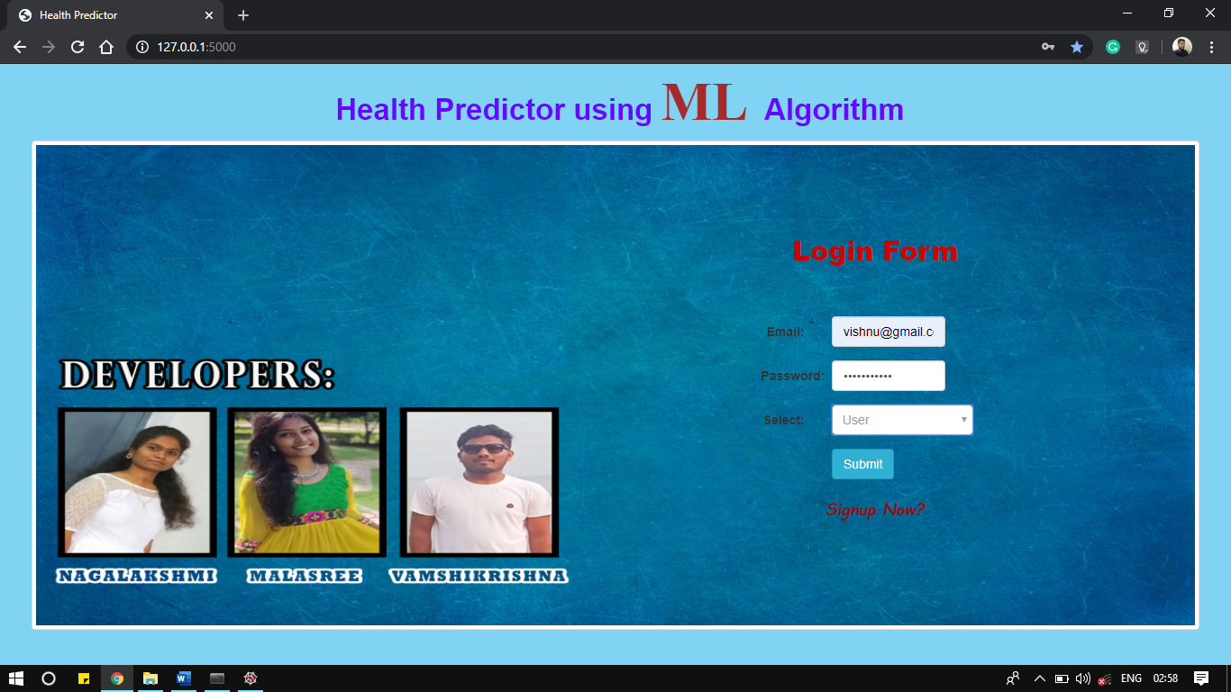
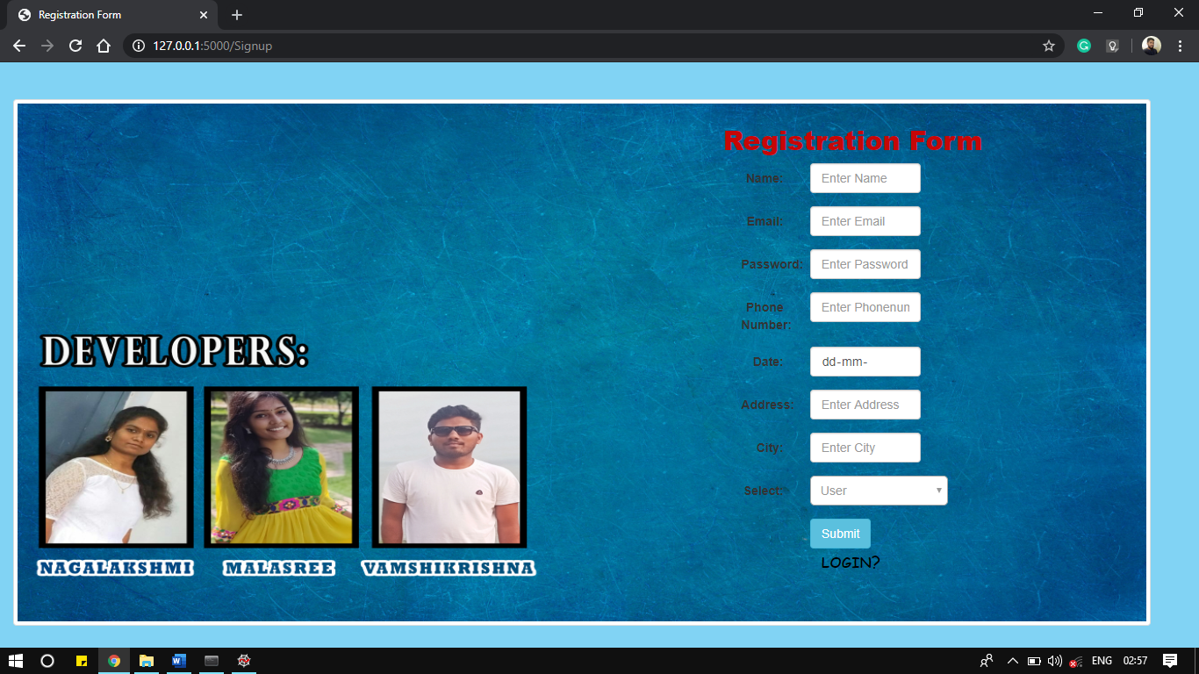
LOGIN PAGE
REGISTRATION PAGE

Slide 17
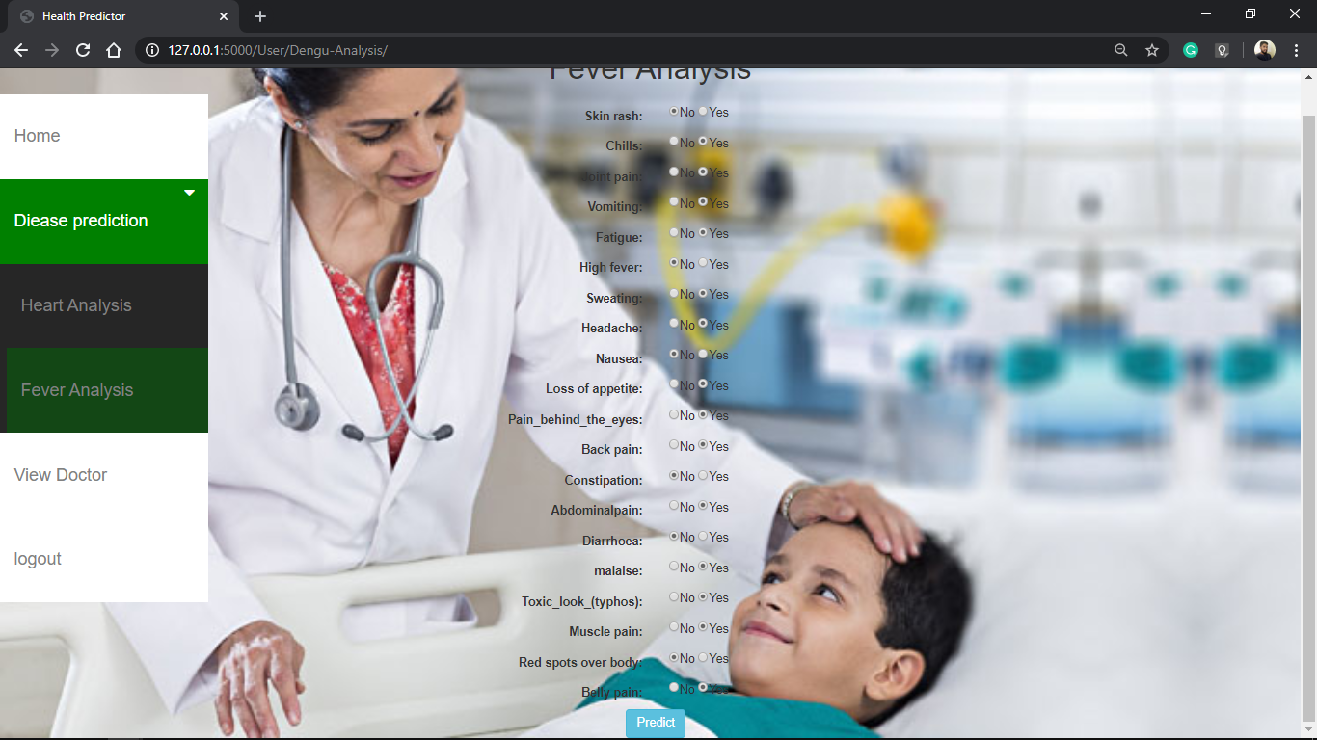
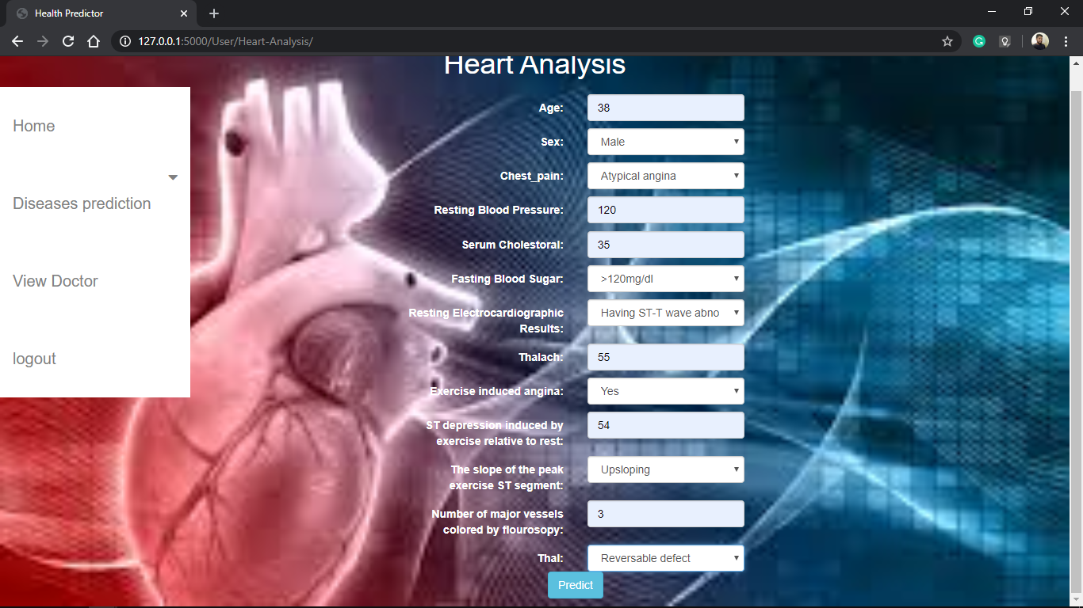
DISEASE PREDICTION PAGE
HEART ANALYSIS PREDICTION PAGE

Slide 18
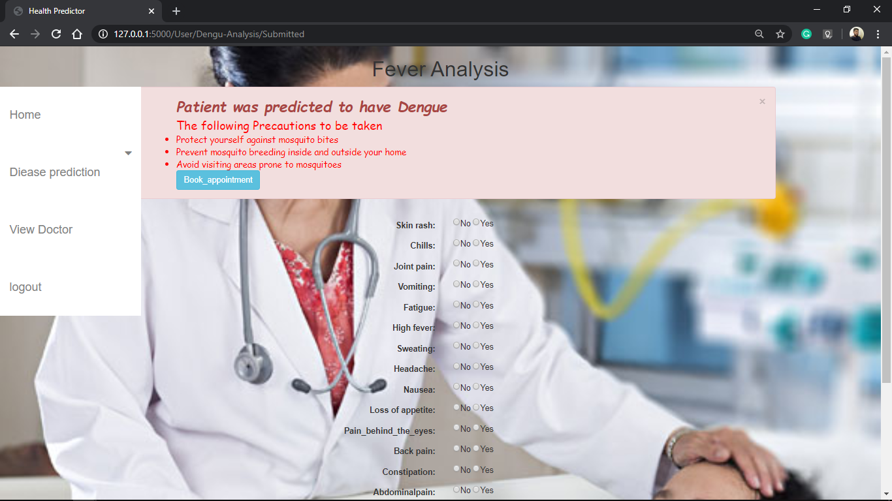
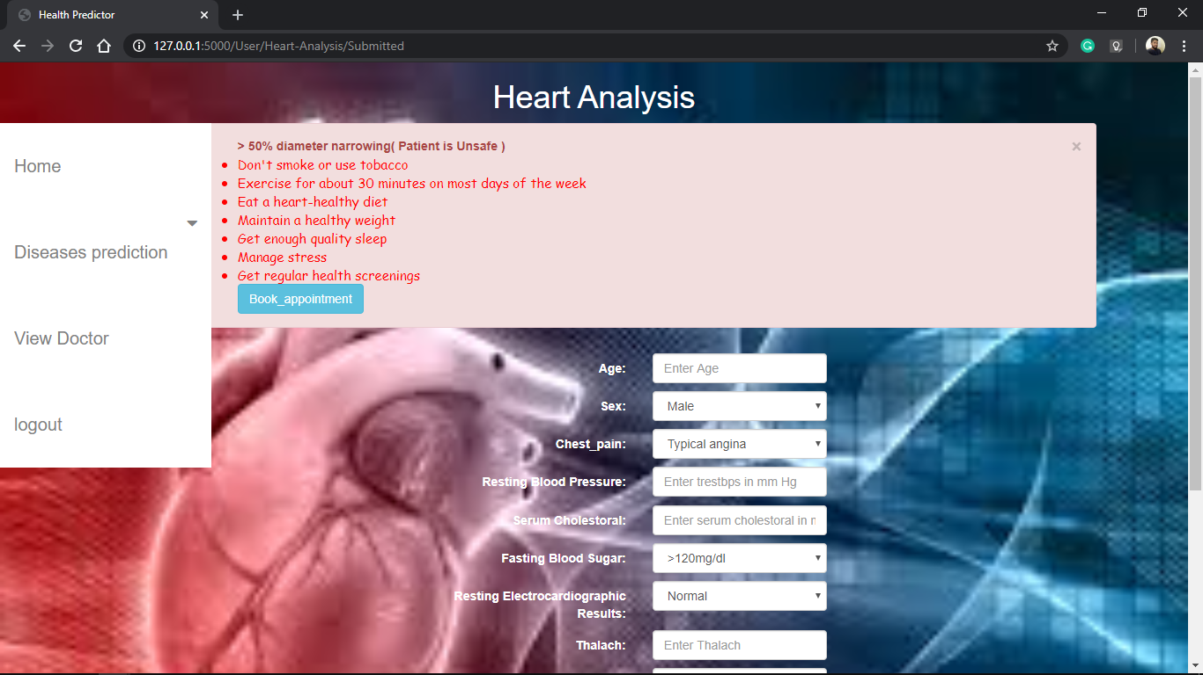
DISEASE PRECAUTIONS PAGE
HEART PRECAUTIONS PAGE

Slide 19


PAPER PROOF

Slide 20
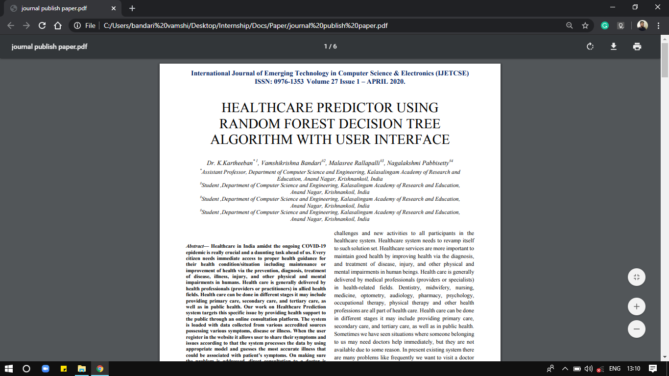

Title: (IJETCSE) International Journal of emerging technology in computer science and electronics
About: IJETCSE is Indexed to large no. of Academic/ Research Databases. The main aim of IJETCSE is to publish the quality and innovative research articles after the peer reviewed.
Impact Factor: 4.780
Email Id: ijetcse@gmail.com
PAPER PUBLISHED COPY
ABOUT JOURNAL

Slide 21
REFERENCES
Shaikh Abdul Hannan, A.V. Mane, R. R. Manza, and R. J. Ramteke, Dec 2010, “Prediction of Heart Disease Medical Prescription using Radial Basis Function”, IEEE International Conference on Computational Intelligence and Computing Research (ICCIC)
Mrudula Gudadhe, Kapil Wankhade, and Snehlata Dongre, Sept 2010,“Decision Support System for Heart Disease Based on Support Vector Machine and Artificial Neural Network”, International Conference on Computer and Communication Technology (ICCCT),DOI:10.1109/ICCCT.2010.5640377, 17-19.
http://www.heart.org/HEARTORG/Conditions/HeartAttack/WarningSignsofa HeartAttack/Warning-Signs-of-aHeartAttack_UCM_002039_Article.jsp#.WNpKgPl97IU.
www.who.int/cardiovascular_diseases/en/. http://food.ndtv.com/health/world-heart-day-2015-heart-disease-in-india-is-agrowing-concern-ansari-1224160.

Slide 22
REFERENCES
Wikipedia on cardiovascular diseases : https://en.wikipedia.org/wiki/Cardiovascular_disease.
AH Chen, SY Huang, PS Hong, CH Cheng, and EJ Lin,2011, “HDPS: Heart Disease Prediction System”, Computing in Cardiology, ISSN: 0276-6574, pp.557- 560.
Manpreet Singh, Levi Monteiro Martins, Patrick Joanis, and Vijay K. Mago,2016, “Building a Cardiovascular Disease Predictive Model using Structural Equation Model & Fuzzy Cognitive Map”, IEEE International Conference on Fuzzy Systems (FUZZ), pp. 1377-1382.
Kaggle – A data set collection hub.

Slide 23
CONCLUSION:
The system would drastically reduce the human effort, and it reduces the cost, time constraint in terms of human resources and expertise by increasing the diagnostic accuracy.
The current work generally helps to open up a new research area.
The models that we used to predict the disease based on user symptoms can be further extended by considering different types of issues/diseases.
There are many possible improvements that can be explored to improve the scalability and accuracy of the prediction system.
Currently we have developed a generalized system. In future we can use these intelligent systems with different data sets containing different symptoms and diseases to train the model.
The performance and the accuracy of the health care can be improved significantly by handling numerous class labels, data sets in the prediction process.

Slide 24
TEAM
Dr K Kartheeban (Guide)
Associate Prof. - CSE
“Alone we can do so little, together we can do Wonders.”
--Helen Keller
Malasree
IV-CSE-B
Nagalakshmi
IV-CSE-B
Vamshikrishna
IV-CSE-C

Slide 25

Venue:
Department of Computer science
Kalasalingam Academy of Research and Education
Krishnankoil, Tamilnadu.

